Slide 1
NCL AMLOHRI CHP Project Photographs
Executed by HAMTEK Technologies India Private Limited

Slide 2
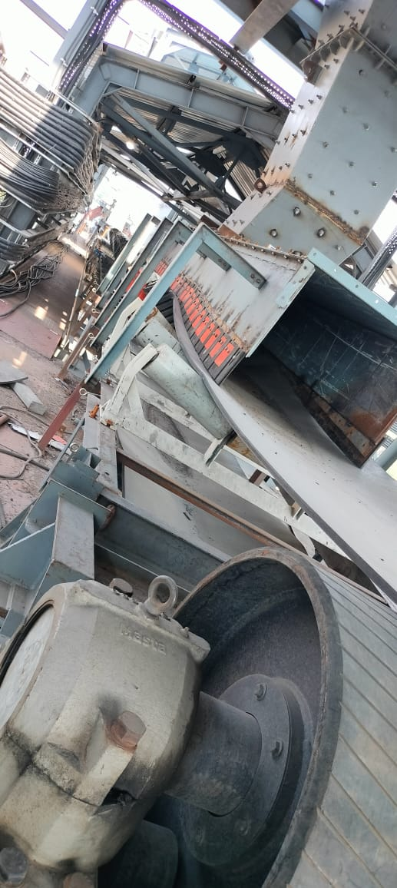
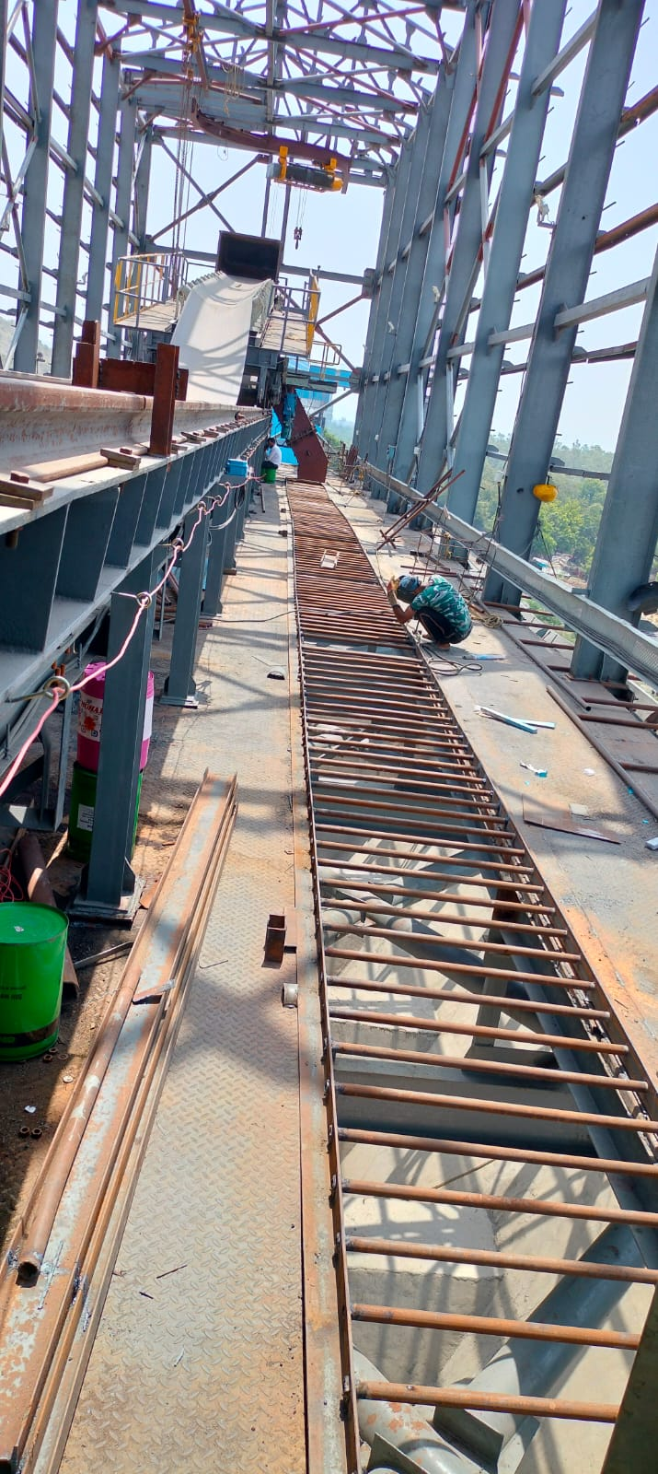
Conveyors
C4 Tripper above Bunker

Slide 3
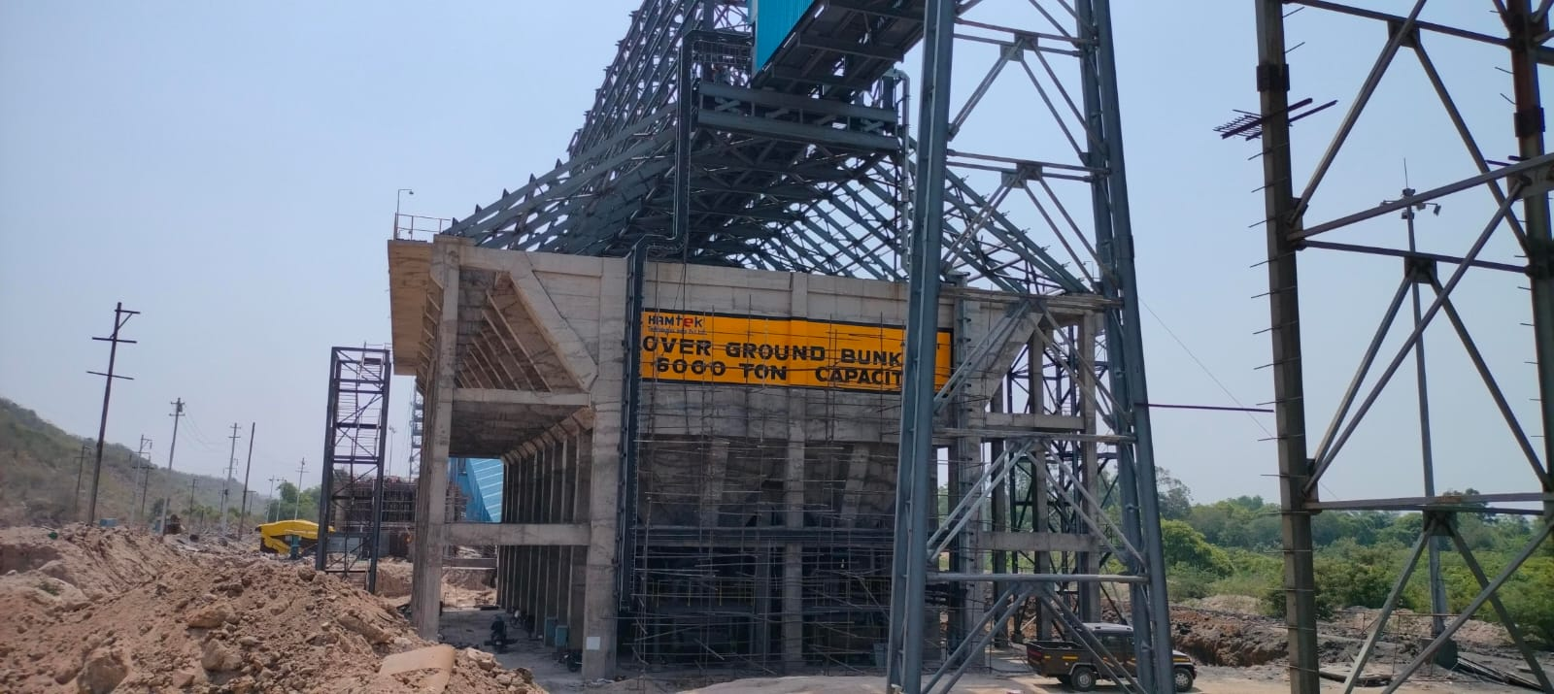
Ground Bunker

Slide 4
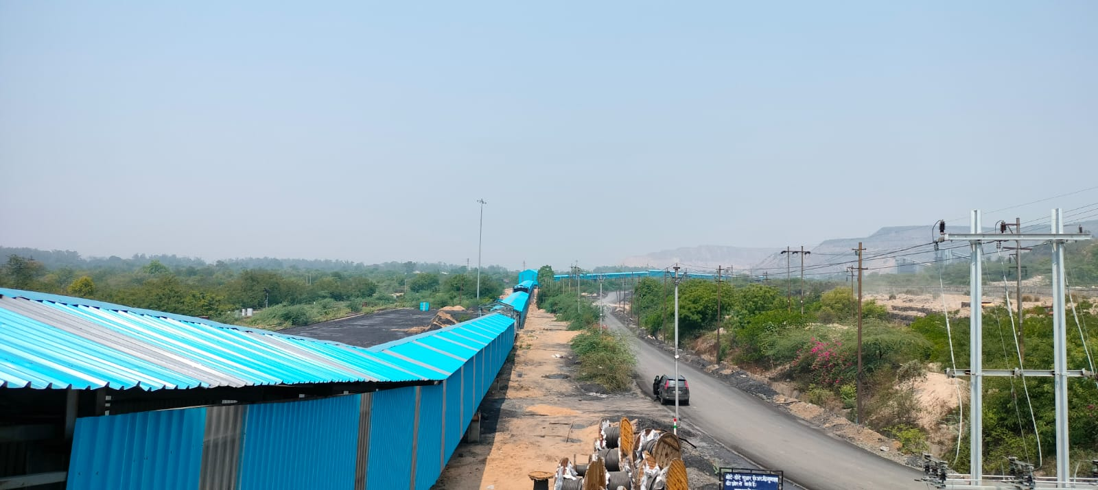
C2&C3 AREA

Slide 5
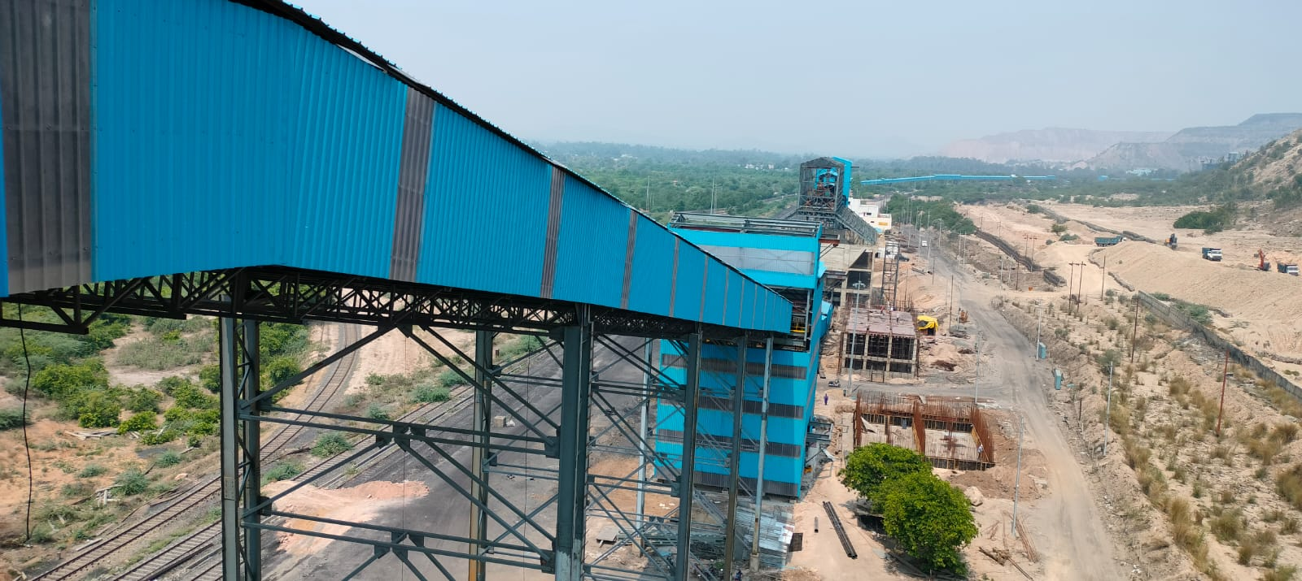
C3,C4, BUNKER, & C5 AREA

Slide 6
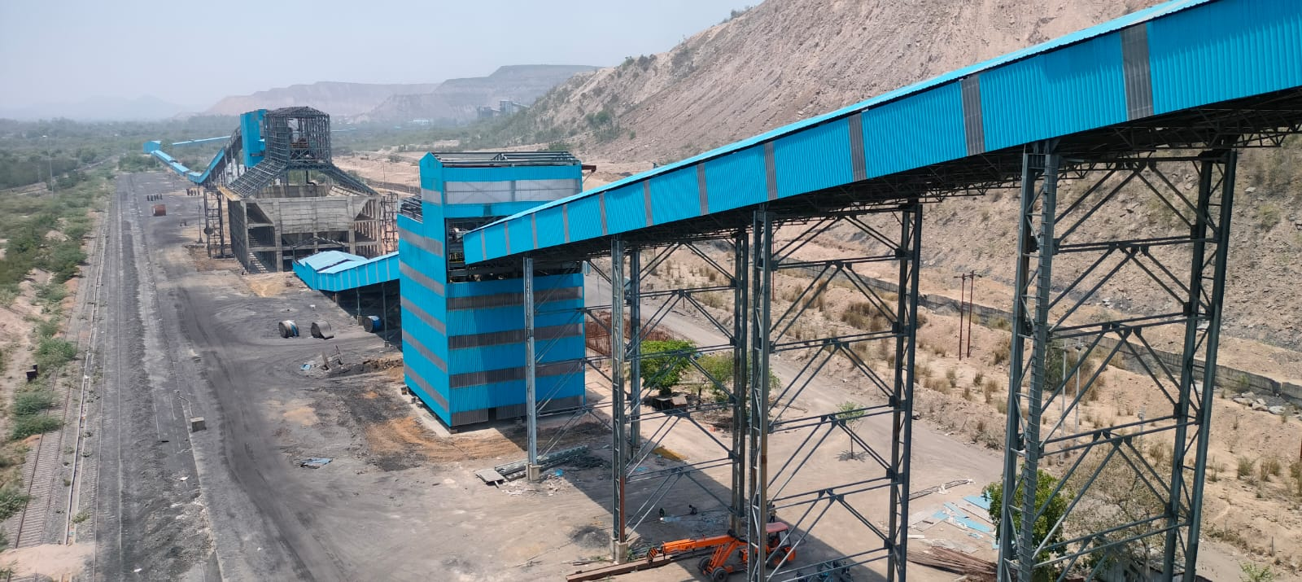
Bunker view

Slide 7
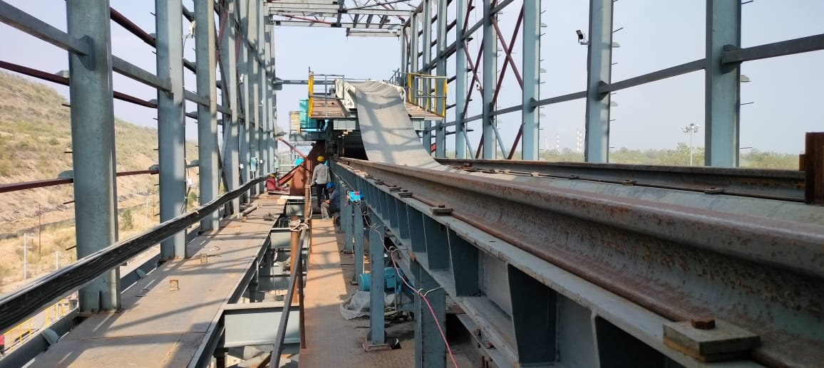
Conveyors
C4

Slide 8
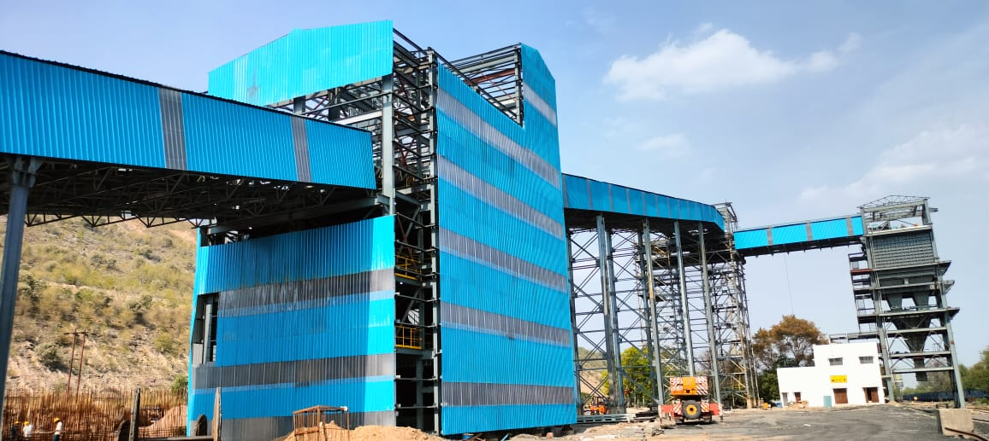
Conveyors
C5.1&2 & C6.1&2 to RLS

